Slide 1

Image Stitching and inpainting
Enee 631
Sayantan Sarkar

Slide 2
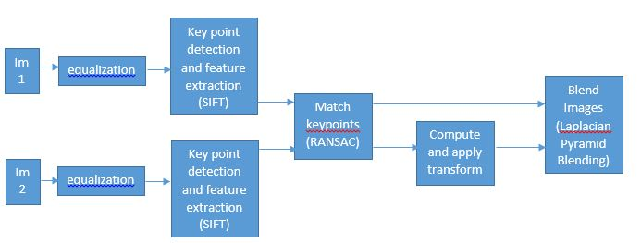
Image Stitching: Introduction
Image Stitching is used to create wide angle panoramas out of multiple images, which capture a scene from multiple viewpoints which have overlapping portions.

Slide 3
Image Stitching: Implementation
2 Modes were implemented. Mode 1 fused 2 images. Mode 2 fuses frames from a video to get the panorama.
2 Implementations both in MATLAB: 1st is the pipeline I described, the second is using MATLAB’s inbuilt functions

Slide 4
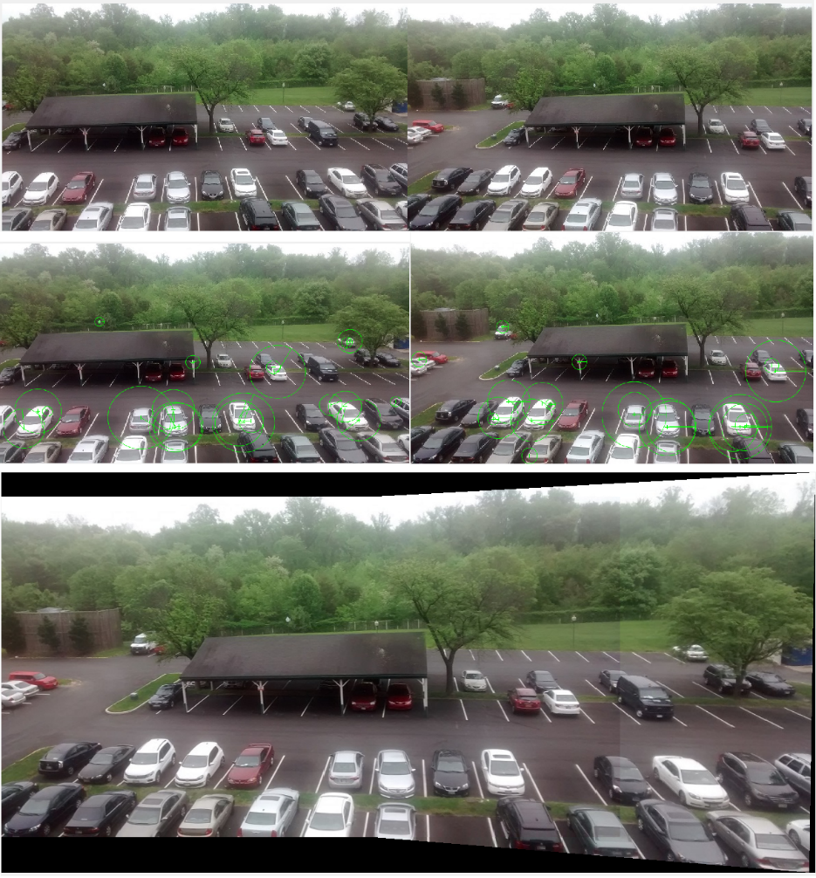
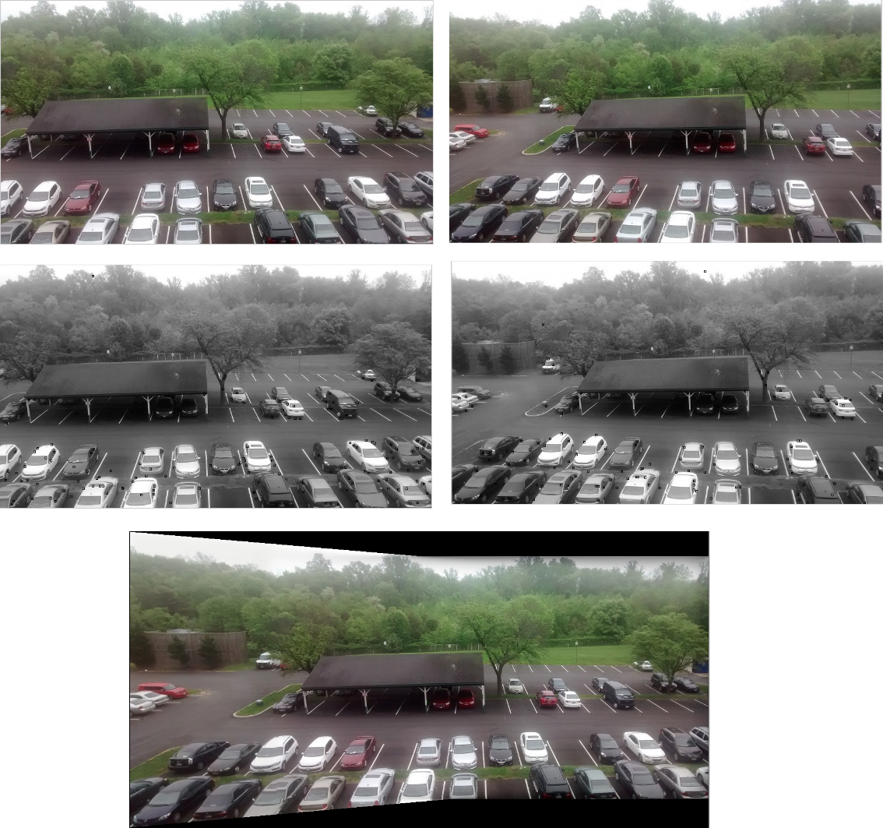
Image Stitching: Results
Left: Inbuilt functions, Right: My pipeline

Slide 5
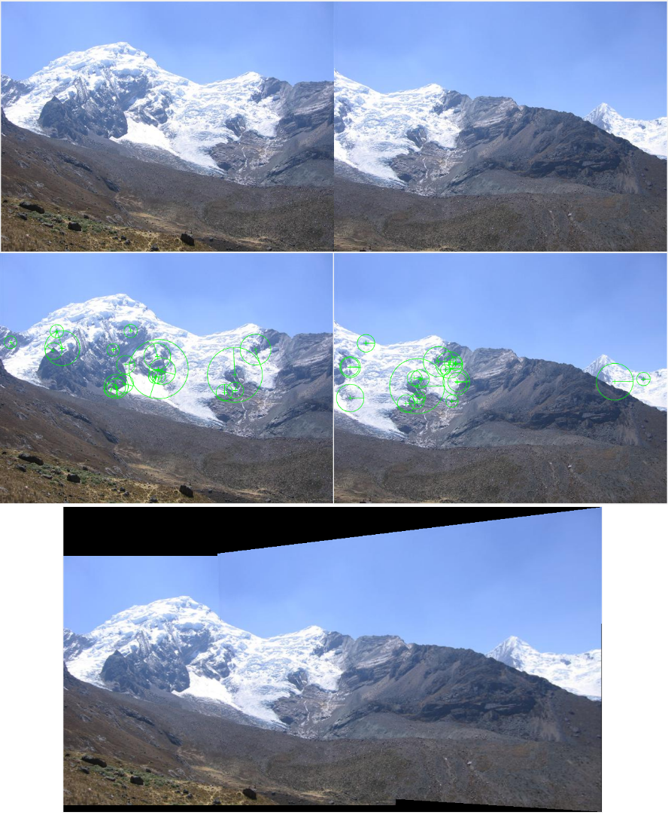
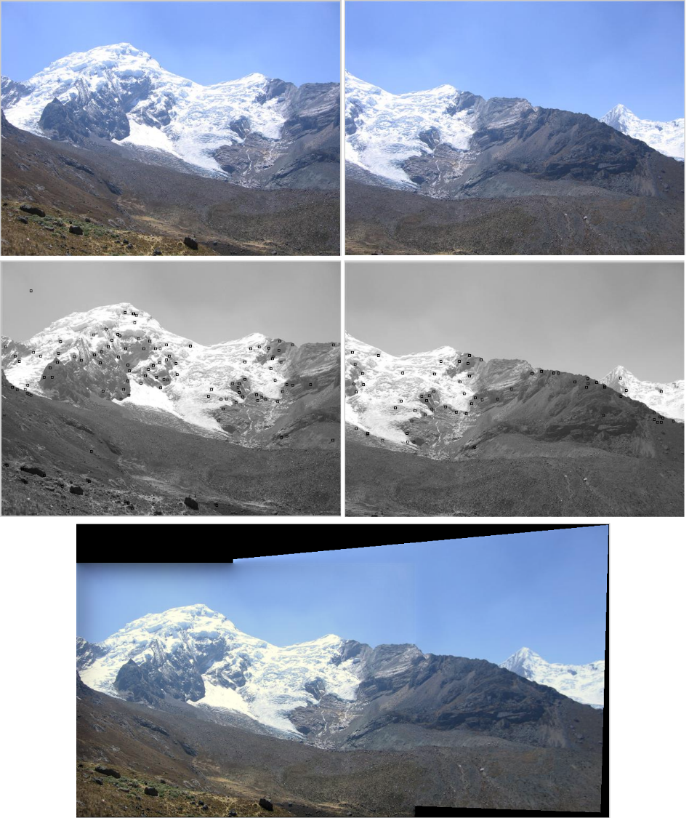
Image Stitching: Results
Left: Inbuilt functions, Right: My pipeline

Slide 6
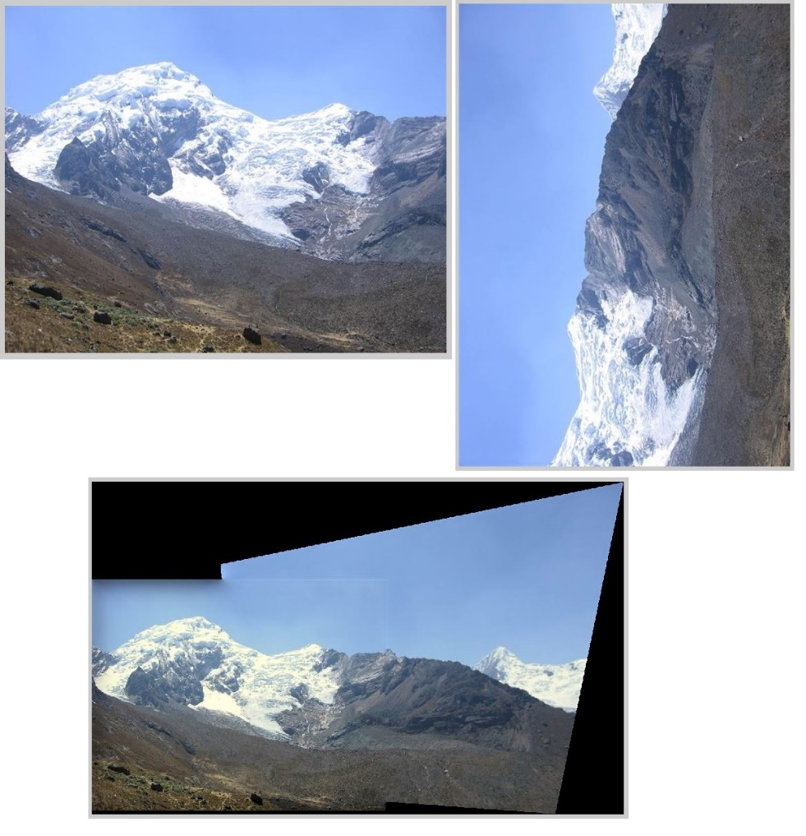
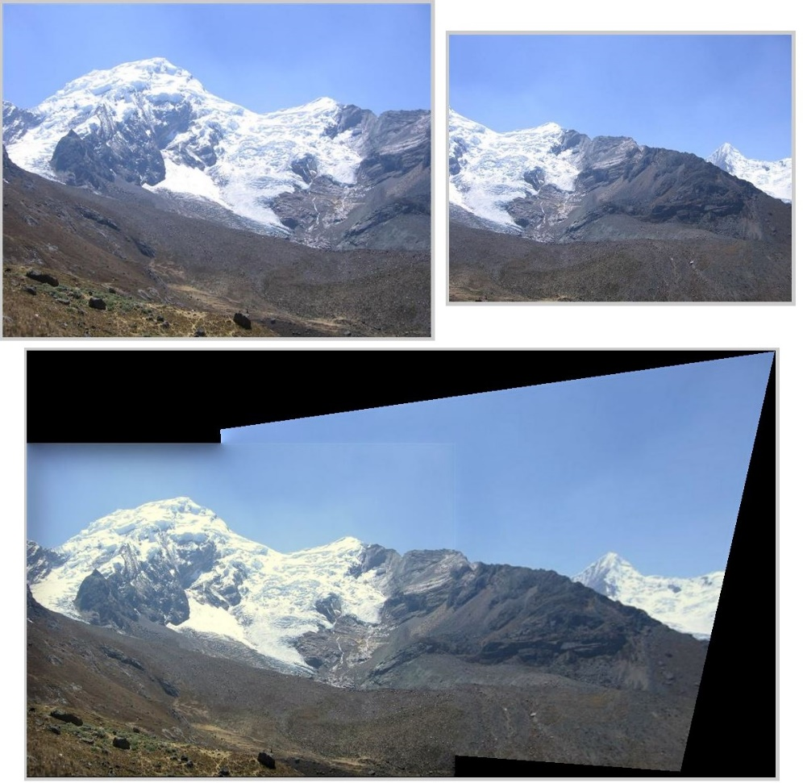
Image Stitching: Results
Stitching rotated images and images of different scales

Slide 7
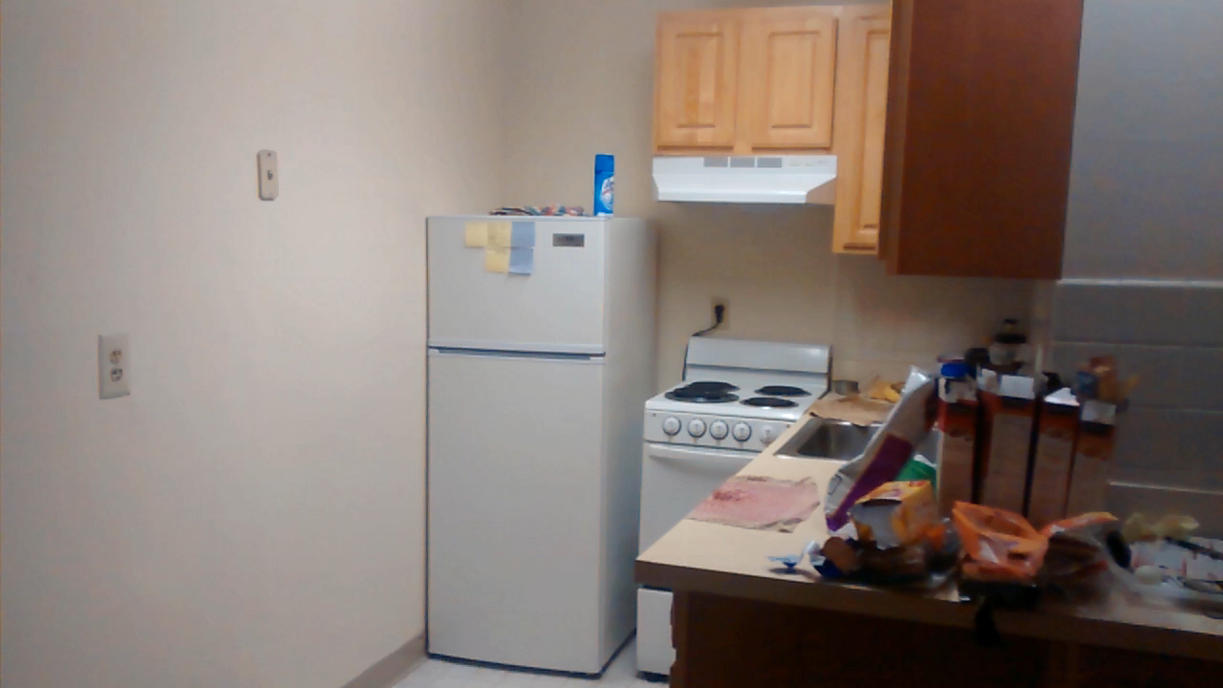
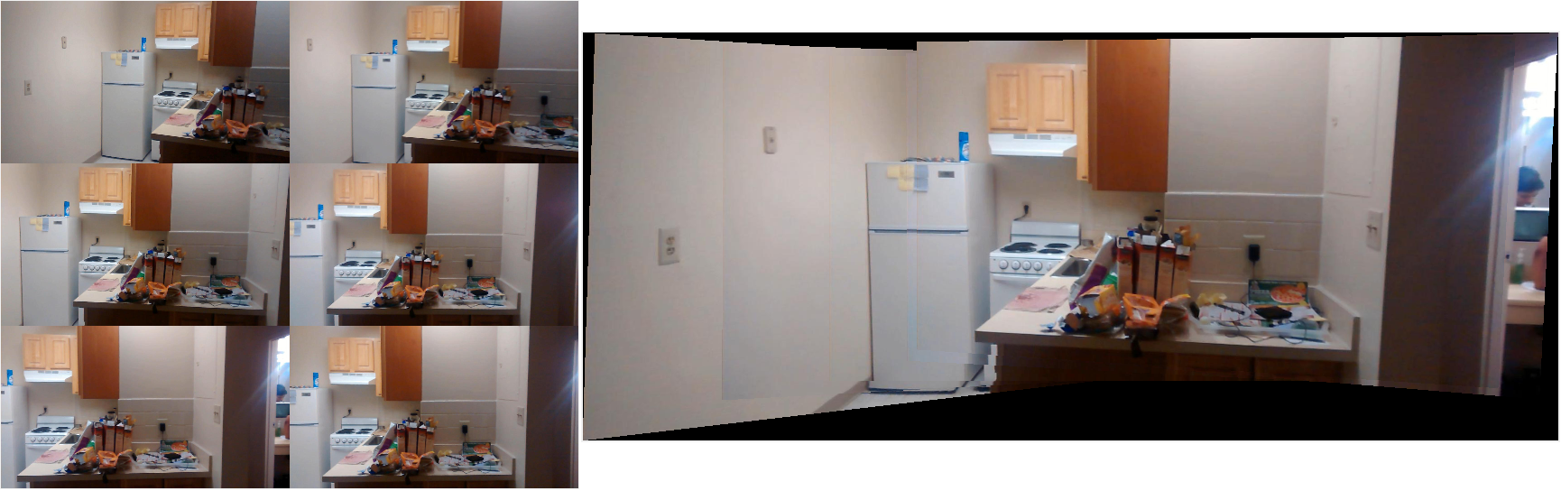
Image Stitching: Results
Video

Slide 8
Image Inpainting: Introduction
Image Inpainting is the process of reconstructing lost or deteriorated parts of images.
Useful for
Restoring old and damaged images
Restore pixels lost during transmission
Remove unwanted objects from an image

Slide 9
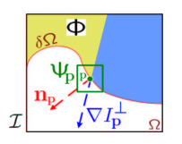
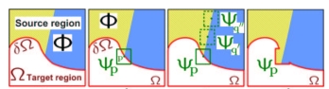
Image Inpainting: Algorithm
Implemented Exemplar based Inpainting as described by Criminisi, Perez and Toyoma
Find a priority point in the fill front using data and confidence term. Data term supports propagation of isophotes, confidence term supports a concentric fill order
Find a patch in the source region that best matches the priority patch and fill it using that.

Slide 10
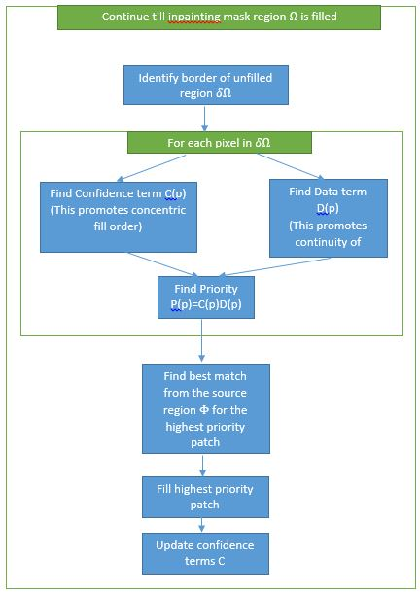
Image Inpainting: Algorithm

Slide 11
Image Inpainting: Implementation
Implemented in C++ (using OpenCV) in Windows
3 modes were implemented
Mode 1: Polygon Mask
Left click to define vertices of a polygon which form a mask
Useful for object removal
Mode 2: Thresholding in Polygon Mask
Left click to define vertices of a polygon that bounds a region of interest
Right click a point that is in the background and is to be removed
Thresholding is applied to infer a mask
Useful to define complex masks (eg for timestamp removal)
Mode 3. Global inpainting
Control + left click on a point and all points with similar colour are considered part of
Useful to define multiple regions in one shot

Slide 12
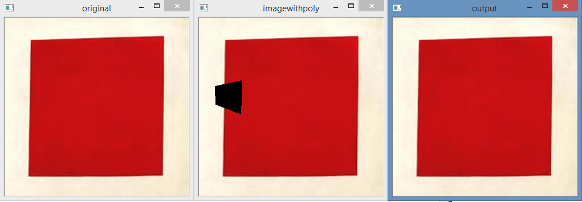
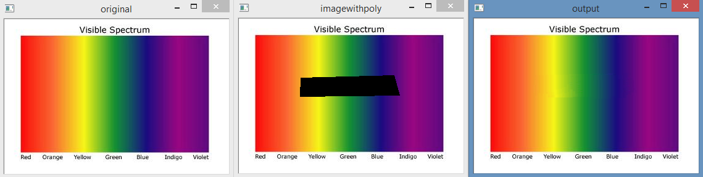
Image Inpainting: Results: Mode 1
Isophote Propagation

Slide 13
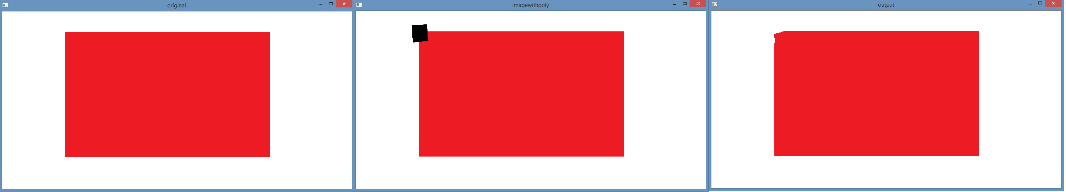
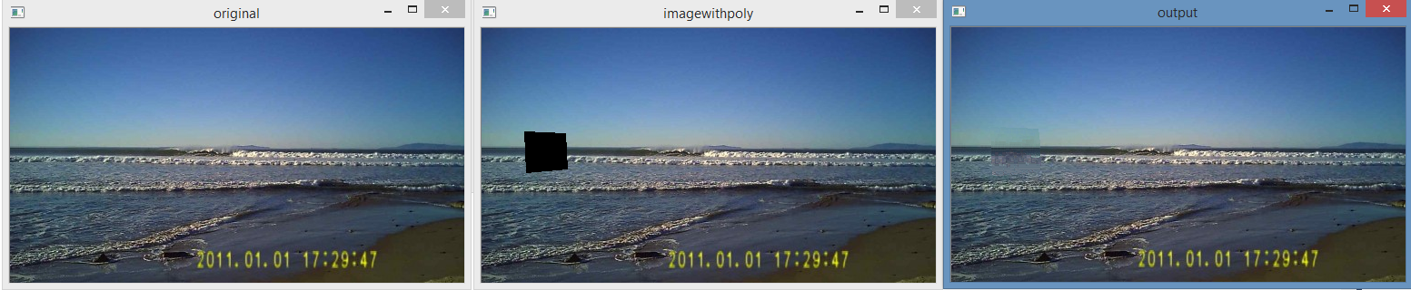
Image Inpainting: Results: Mode 1
Isophote Propagation

Slide 14
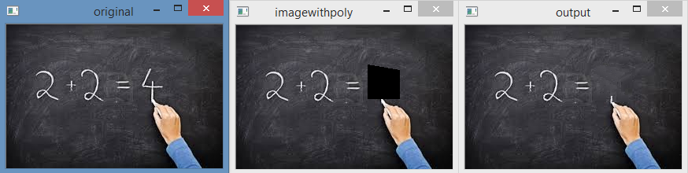
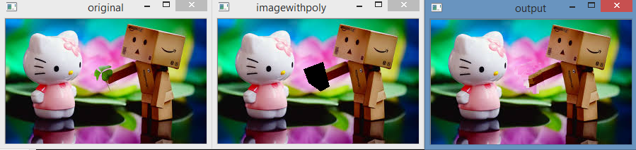
Image Inpainting: Results: Mode 1
Object removal

Slide 15
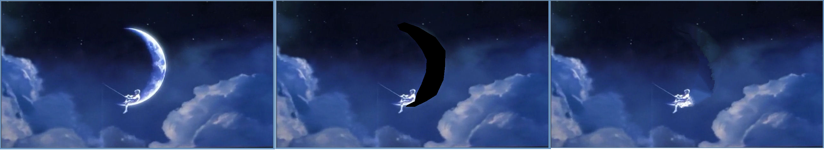
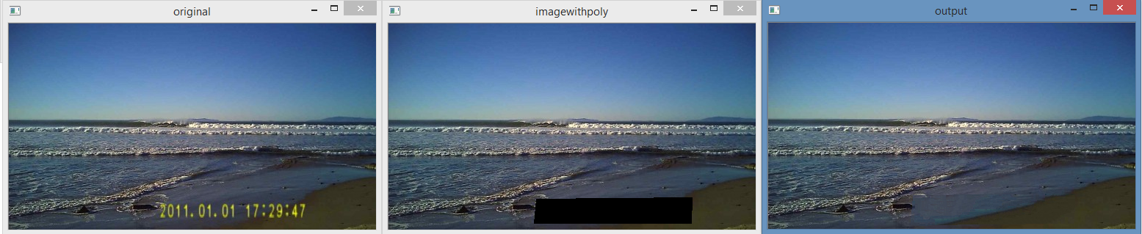
Image Inpainting: Results: Mode 1
Object removal

Slide 16
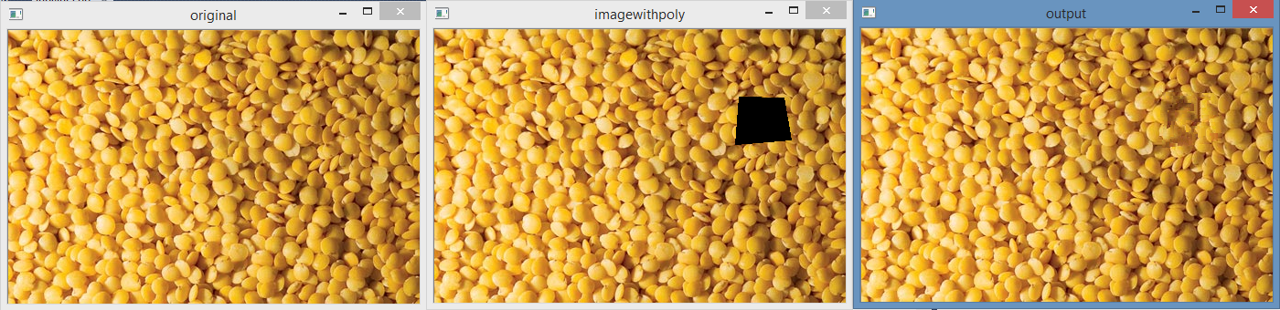
Image Inpainting: Results: Mode 1
Texture Generation

Slide 17
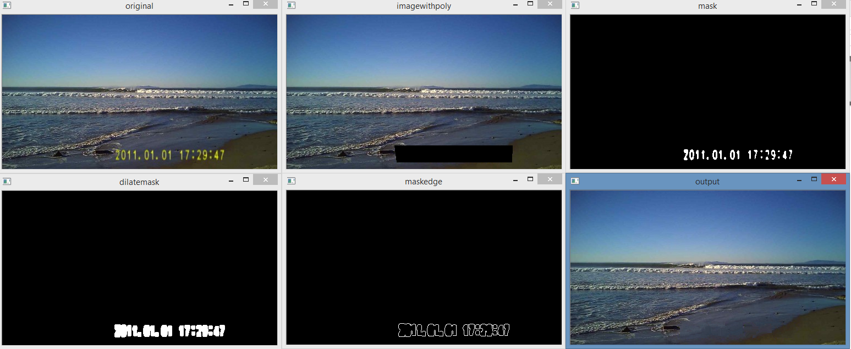
Image Inpainting: Results: Mode 2

Slide 18
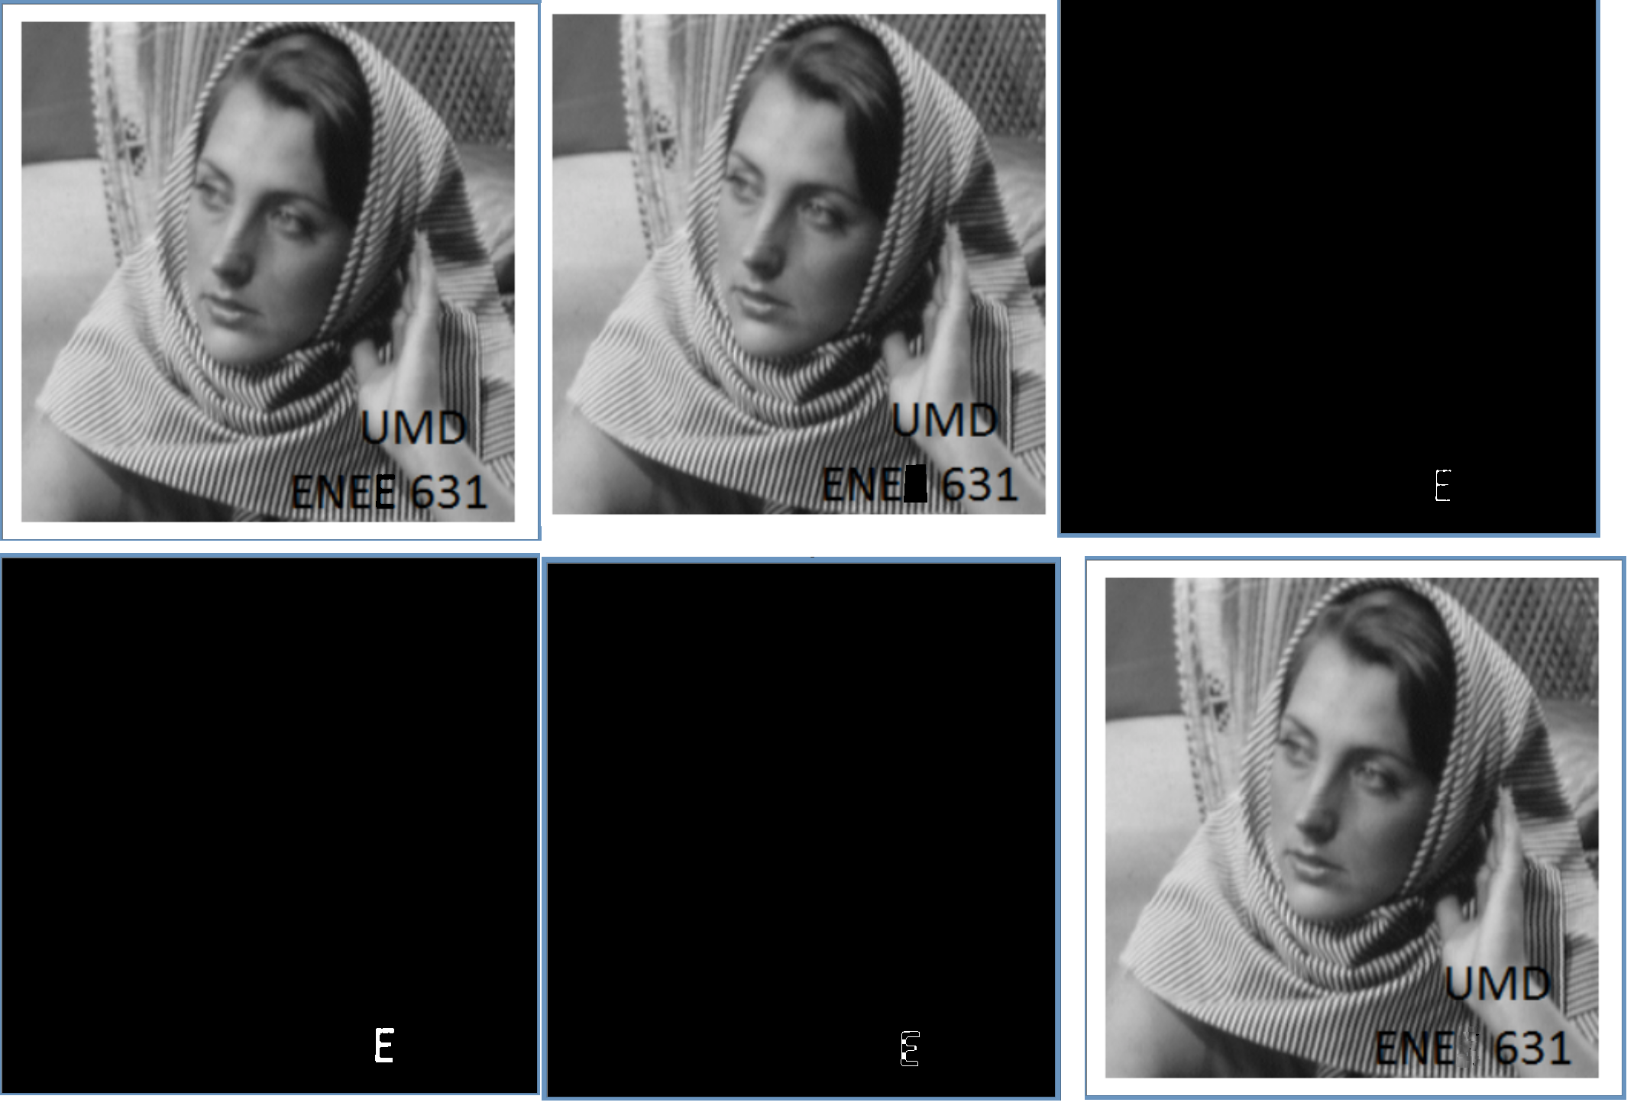
Image Inpainting: Results: Mode 2

Slide 19
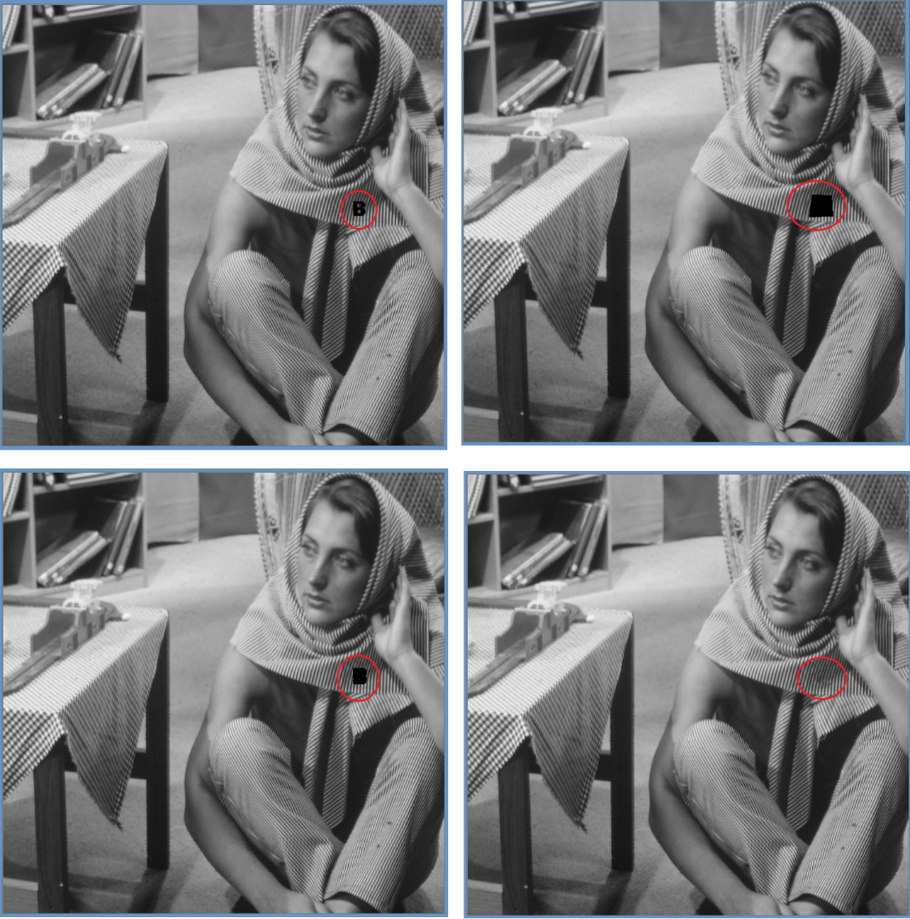
Image Inpainting: Results: Mode 2

Slide 20
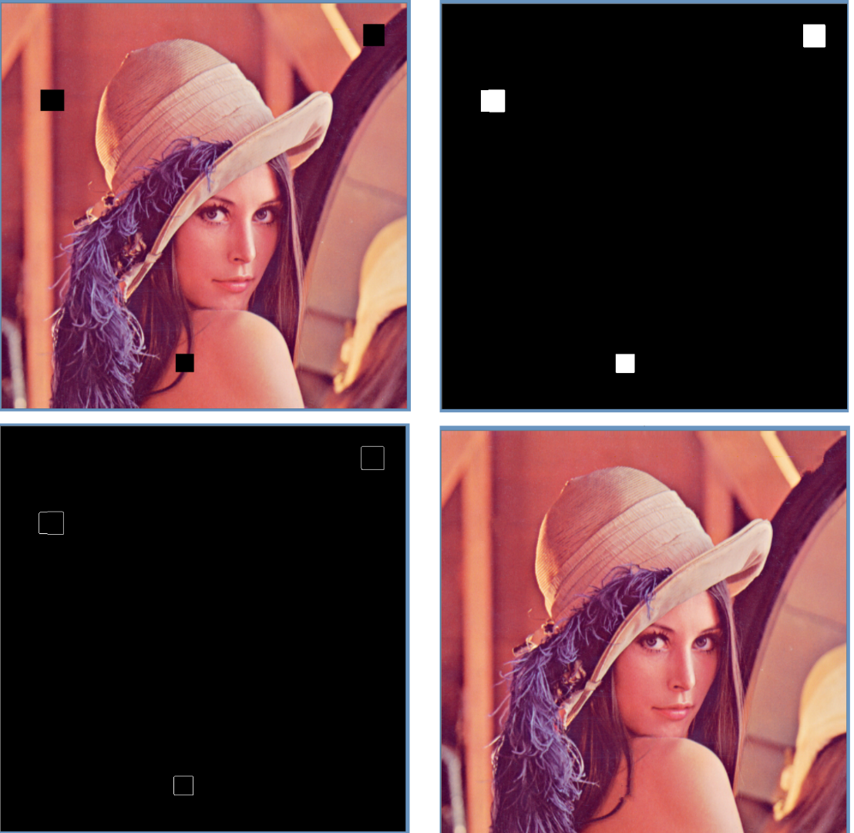
Image Inpainting: Results: Mode 3

Slide 21
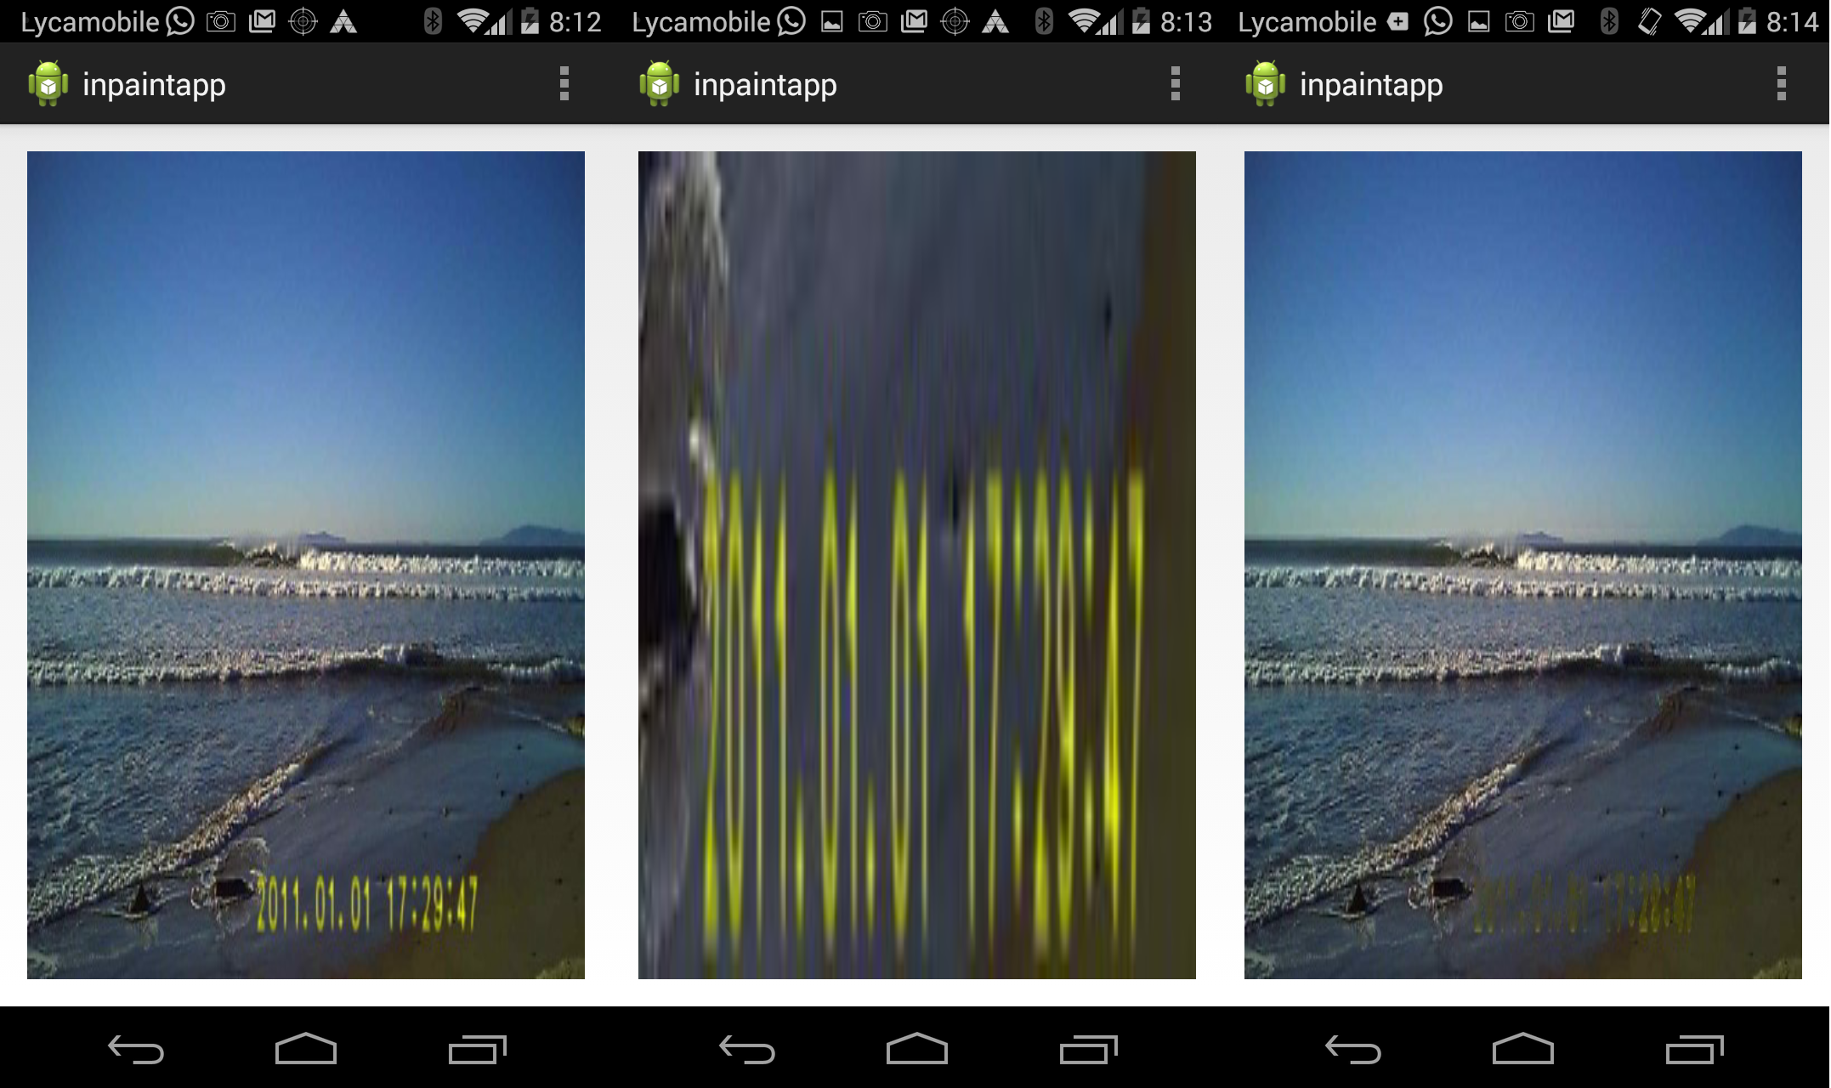
Image Inpainting: Android
Also developed an app in android to do inpainting using inbuilt functions in OpenCV
User can select a rectangular region of interest. Otsu’s Thresholding is performed that gives a mask. Then inpainting is done.

Slide 22
References
General
[1] http://en.wikipedia.org/wiki/Image_stitching
[2] http://en.wikipedia.org/wiki/Inpainting
[3] Szeliski, Richard. "Image alignment and stitching: A tutorial." Foundations and Trends® in Computer Graphics and Vision 2.1 (2006): 1-104.
[4] http://www.mathworks.com/help/vision/examples/feature-based-panoramic-image-stitching.html
SIFT
[5] http://www.inf.fu-berlin.de/lehre/SS09/CV/uebungen/uebung09/SIFT.pdf
[6] https://www.youtube.com/watch?v=NPcMS49V5hg
[7] http://web.eecs.umich.edu/~silvio/teaching/EECS598/lectures/lecture10_1.pdf
RANSAC
[8] http://en.wikipedia.org/wiki/RANSAC
[9] http://www.cse.yorku.ca/~kosta/CompVis_Notes/ransac.pdf
Blending
[10] http://graphics.cs.cmu.edu/courses/15-463/2005_fall/www/Lectures/Pyramids.pdf
[11] http://www.cs.toronto.edu/~jepson/csc320/notes/pyramids.pdf
[12] Burt, P. J. and Adelson, E. H., A multiresolution spline with applications to image mosaics, ACM Transactions on Graphics, 42(4), October 1983, 217-236
[13] http://pages.cs.wisc.edu/~csverma/CS766_09/ImageMosaic/imagemosaic.html
Inpainting
[14] Toyama, C. E., Criminisi, A., Pérez, P., & Toyama, K. (2003). Object removal by exemplar-based inpainting.

